Slide 1
A 64Mb SRAM for 37% Leakage Reduction
Manny Xu CKT
201805

Slide 2
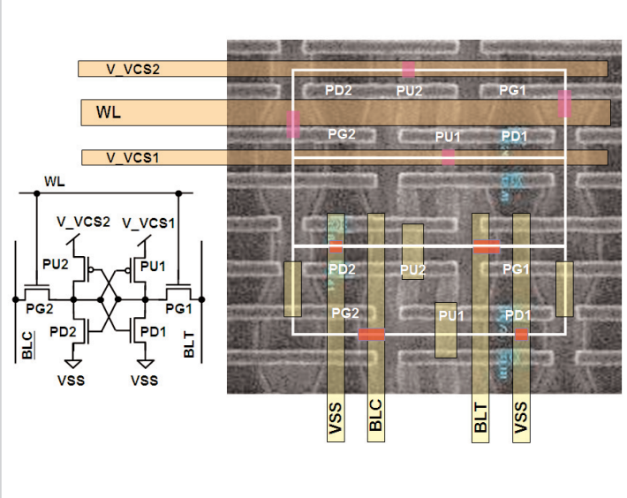
Notes:
BL capacitance monitor working as a replica of a BL generates a signal activating the bootstrap (boost_en). Every WL driver has a pull-down unit (PDU) to lower the WL voltage for optimizing the tradeoff between disturb and write margin.

Slide 3
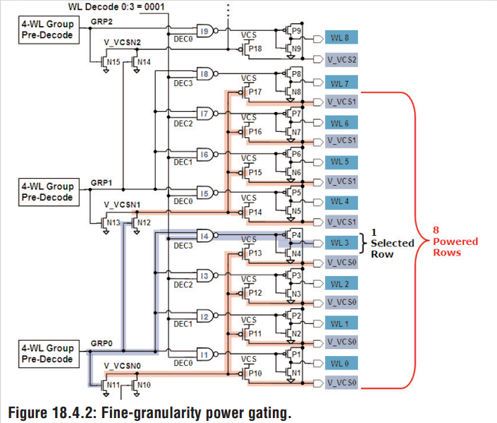
Notes:
BL capacitance monitor working as a replica of a BL generates a signal activating the bootstrap (boost_en). Every WL driver has a pull-down unit (PDU) to lower the WL voltage for optimizing the tradeoff between disturb and write margin.

Slide 4
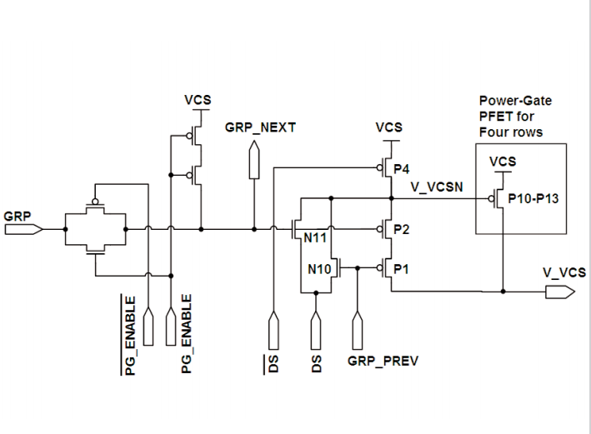
Notes:
BL capacitance monitor working as a replica of a BL generates a signal activating the bootstrap (boost_en). Every WL driver has a pull-down unit (PDU) to lower the WL voltage for optimizing the tradeoff between disturb and write margin.

Slide 5
Thank you

